Slide 1
2.2 RENEWABLE AND NON-RENEWABLE RESOURCES
2.2.1 Natural resources and associated problems:
a). The unequal consumption of natural resources:
A major part of natural resources are today consumed in the technologically advanced or ‘developed’ world, usually termed ‘the North’.
The ‘developing nations’ of ‘the South’, including India and China, also over use many resources because of their greater human population.

Slide 2
However, the consumption of resources per capita (per individual) of the developed countries is up to 50 times greater than in most developing countries.
Advanced countries produce over 75% of global industrial waste and greenhouse gases.

Slide 3
Energy from fossil fuels is consumed in relatively much greater quantities in developed countries.
Their per capita consumption of food too is much greater as well as their waste of enormous quantities of food and other products, such as packaging material, used in the food industry.
The USA for example with just 4% of the world’s population consumes about 25% of the world’s resources.

Slide 4
Producing animal food for human consumption requires more land than growing crops.
Thus countries that are highly dependent on non-vegetarian diets need much larger areas for pastureland than those where the people are mainly vegetarian.

Slide 5
b). Planning Landuse:
Land itself is a major resource, needed for food production, animal husbandry, industry, and for our growing human settlements.
These forms of intensive landuse are frequently extended at the cost of ‘wild lands’, our remaining forests, grasslands, wetlands and deserts.
Thus it is essential to evolve a rational land-use policy that examines how much land must be made available for different purposes and where it must be situated.
.

Slide 6
For Ex:, There are usually alternate sites at which industrial complexes or dams can be built, but a natural wilderness cannot be recreated artificially.
Scientists today believe that at least 10 percent of land and water bodies of each ecosystem must be kept as wilderness for the long term needs of protecting nature and natural resources

Slide 7
Now a days, an increasing ‘land hunger’ - to produce sufficient quantities of food for an exploding human population.
It is also affected by degradation, Land and water resources are polluted by industrial waste and rural and urban sewage.
They are increasingly being diverted for short-term economic gains to agriculture and industry.
Forests have vanished rapidly during recent times, both in India and in the rest of the world.

Slide 8
The need for sustainable lifestyles
The quality of human life and the quality of ecosystems on earth are indicators of the sustainable use of resources.
There are indicators of sustainable lifestyles in human life.
i). Increased longevity
ii). An increase in knowledge
iii). An enhancement of income.
These three together are known as the ‘Human
development index’.

Slide 9
The need for sustainable lifestyles
The quality of the ecosystems have indicators that are more difficult to assess.
A stabilized population.
The long term conservation of biodiversity.
The careful long-term use of natural resources.
The prevention of degradation and pollution of the environment.

Slide 10
2.2.2 Non-renewable resources
These are minerals that have been formed in the lithosphere over millions of years and constitute a closed system.
These non-renewable resources, once used, remain on earth in a different form and, unless recycled, become waste material.
Non-renewable resources include:
fossil fuels - oil and coal, which if extracted at the present rate, will soon be totally used up.
The end products of fossil fuels are in the form of heat and mechanical energy and chemical compounds, which cannot be reconstituted as a resource.

Slide 11
2.2.3 Renewable resources
Renewable resources may become Non renewable :
Though water and biological living resources are considered renewable. They are in fact renewable only within certain limits.
When water sources can be overused or wasted to such an extent that they locally run dry Water sources can be so heavily polluted by sewage and toxic substances that it becomes impossible to use the water.

Slide 12
Forests, once destroyed take thousands of years to re grow into fully developed natural ecosystems with their full complement of species.
Forests thus can be said to behave like non-renewable resources if overused.

Slide 13
Fish are today being over-harvested until the catch has become a fraction of the original resource and the fish are incapable of breeding successfully to replenish the population.
The output of agricultural land if mismanaged drops drastically.

Slide 14
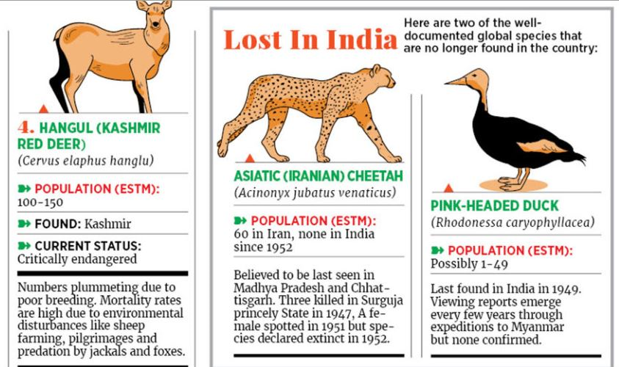
When the population of a species of plant or animal is reduced by human activities, until it cannot reproduce fast enough to maintain a viable number, the species becomes extinct.
Many species are probably becoming extinct without us even knowing, and other linked species are affected by their loss.

Slide 15
Activity 2.3: Utilisation of resources Environmental management.
The use of a resource begins with its collection, its processing into a useable product, and transport through a delivery system, to the consumer who uses it.
It also involves disposal of the waste products produced at each step.
Each step in resource use can affect the environment for better or worse.
The control of these steps is known as environmental management.

Slide 16
ACTIVITY 2.3
Think of a resource you use and track it through these steps.
Eg. The cotton in the clothes you are wearing.
At each step note:
What other resources are needed at this step to move the resource you chose to the next?
What waste products are generated at that step?
How are they likely to be disposed off?
What pollutants are generated in the process?

Slide 17
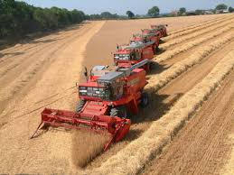
Misuse of Natural Resources - EXAMPLES
Misuse of natural resources refers to excessive use, destructive use or achieving imbalance between resources either individually or in combination.
Excessive mining.
Loss of forest area (if mines are in forest).
Displacement of population and their profession
Loss of agricultural / forest area in standing water (in dam construction).
Loss of biodiversity

Slide 18
Unnatural crosses between species
Transgenic breeding leading to modification of original characters of plants to destroy natural plant types interfering in natural regeneration process.
Excessive fishing around the coast.
Premature fishing for commercial purpose.
Interference in natural breeding by in-vitro fertilization (IVF) and artificial insemination technique(AI)

Slide 19
Human resources MISUSED:
Discriminating the human beings on sex
(Male /Female)
Abuse of children as cheap source of labour.
Bonded labours .
{According to official data, there are around 152 million children worldwide working as child labourers,
out of which India accounts for close to 7.3 per cent of that number. ...
Rural India has the highest percentage of child labour, accounting to 80% of the total burden in India. : -Jun 12, 2020 Times of India}

Slide 20
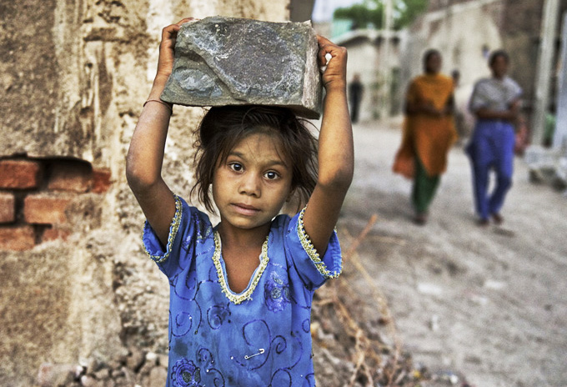
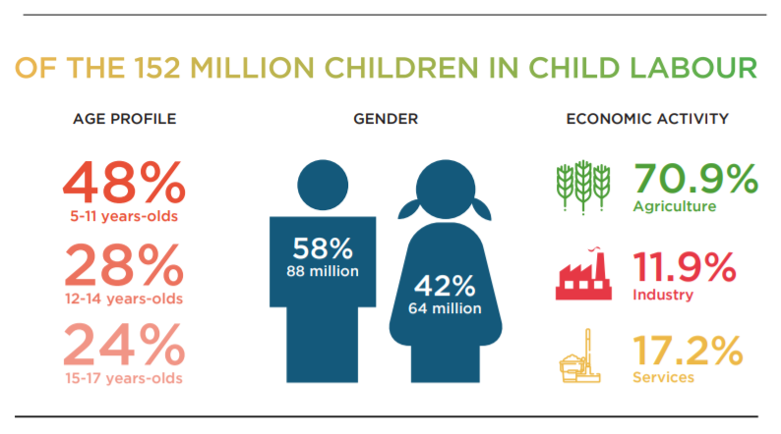
Child labour

Slide 21
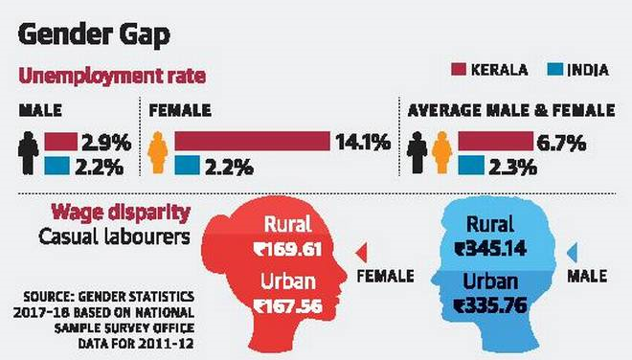
Gender discrimination

Slide 22
Microbial resources : bio warfare:
Biological wars and its agents like Anthrax
Biological warfare (BW)—also known as germ warfare—is the use of biological toxins or infectious agents such as bacteria, viruses, insects, and fungi with the intent to kill or incapacitate humans, animals or plants as an act of war.

Slide 23
Next Lecture (L3)
Forest Resources
_______________
Thank you

